Slide 1
Introduction to Artificial Intelligence & Machine Learning

Slide 2
What is Artificial Intelligence?
The broadest field. Any method that makes machines mimic human intelligence. From problem-solving to decision-making.
AI is not just one tool or one product. It’s a hierarchy of technologies, each layer building on the last.
Notes:
Artificial intelligence
AI journey (70+ years)
Pervasive impact (everyday life)
ML/DL boom (last decade)
Industry adoption
Cloud’s role (open source + new use cases)

Slide 3
Key Components and Methodologies
AI vs ML vs Deep Learning
Analogy: Think of transportation:
AI = the idea of “getting from A to B automatically.”
ML = designing a car that learns how to drive by itself.
Deep Learning = using a self-driving Tesla with advanced sensors & neural nets.
Notes:
Key Points
AI (Artificial Intelligence)
Broadest concept.
Gives machines the ability to imitate human behavior.
ML (Machine Learning)
Subset of AI.
Helps machines self-learn and improve continually.
DL (Deep Learning)
Subset of ML.
Uses complex algorithms & deep neural networks.
Repeatedly trains models/patterns.

Slide 4
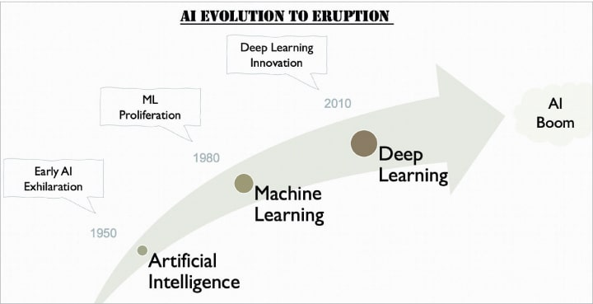
Evolution of AI, ML and DL
Notes:
“Early AI exhilaration was like the moon landing moment for AI — people thought machines would soon think, talk, and act like humans.
But the reality was that AI was still a toddler trying to walk.”
ML Proliferation = ML spreading everywhere, becoming part of almost every industry and product.

Slide 5
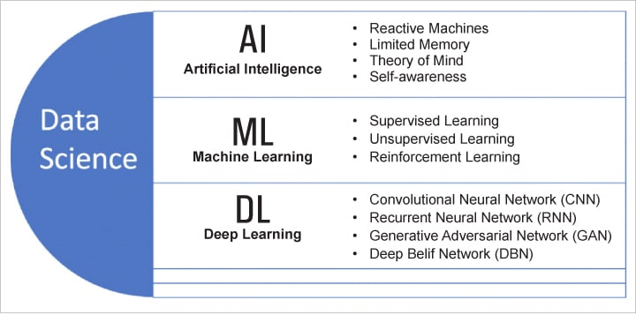
Types of AI, ML and DL

Slide 6
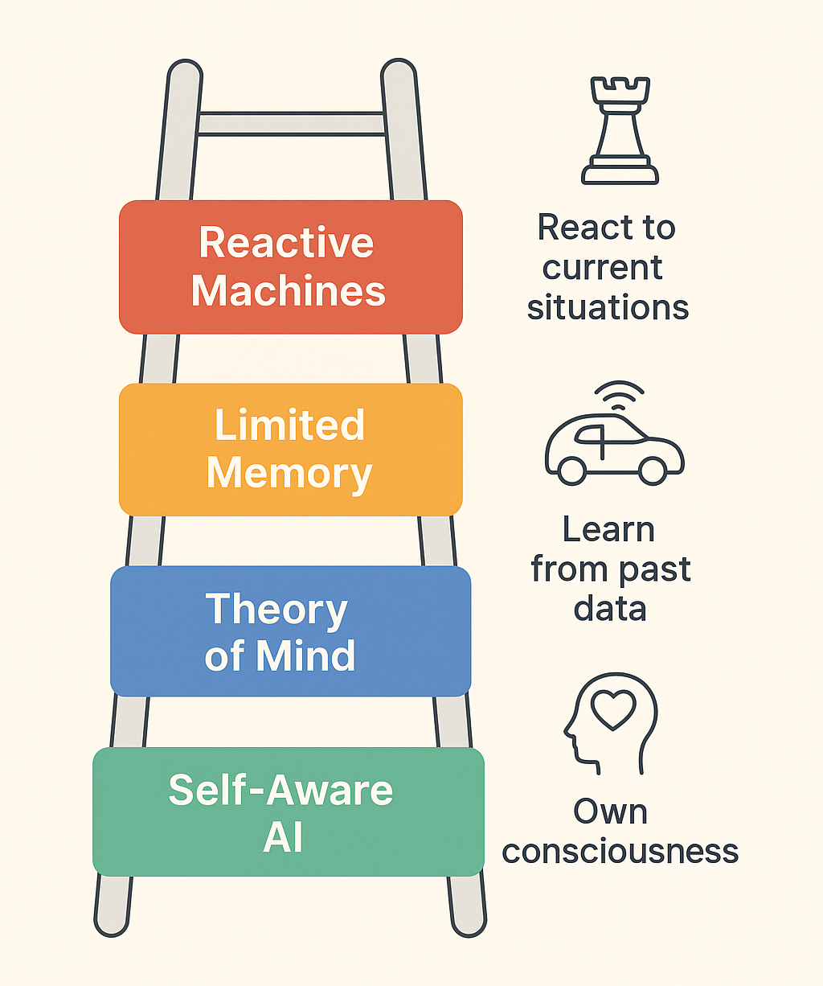
Types of AI
Notes:
1. Reactive Machines
What it is: AI that can react to current situations but cannot use past experiences.
Key feature: No memory, no learning from the past.
Example: IBM’s Deep Blue chess computer. It can evaluate moves and play well but doesn’t “remember” past games.
2. Limited Memory
What it is: AI that can learn from past data to make better decisions.
Key feature: Uses historical data for short-term decision-making.
Example: Self-driving cars observe other vehicles, pedestrians, and traffic patterns to decide actions.
3. Theory of Mind
What it is: AI that can understand emotions, beliefs, and thoughts of humans.
Key feature: Can interact socially and anticipate human behavior.
Status: Mostly research-level, not fully realized yet.
Example (conceptual): Robots that can understand when a human is frustrated or happy.
4. Self-Aware AI
What it is: AI that has its own consciousness, awareness, and emotions.
Key feature: Can understand itself and others; fully autonomous thinking.
Status: Theoretical/futuristic; does not exist yet.
Example (conceptual): A robot that knows it exists and can plan its own future.

Slide 7
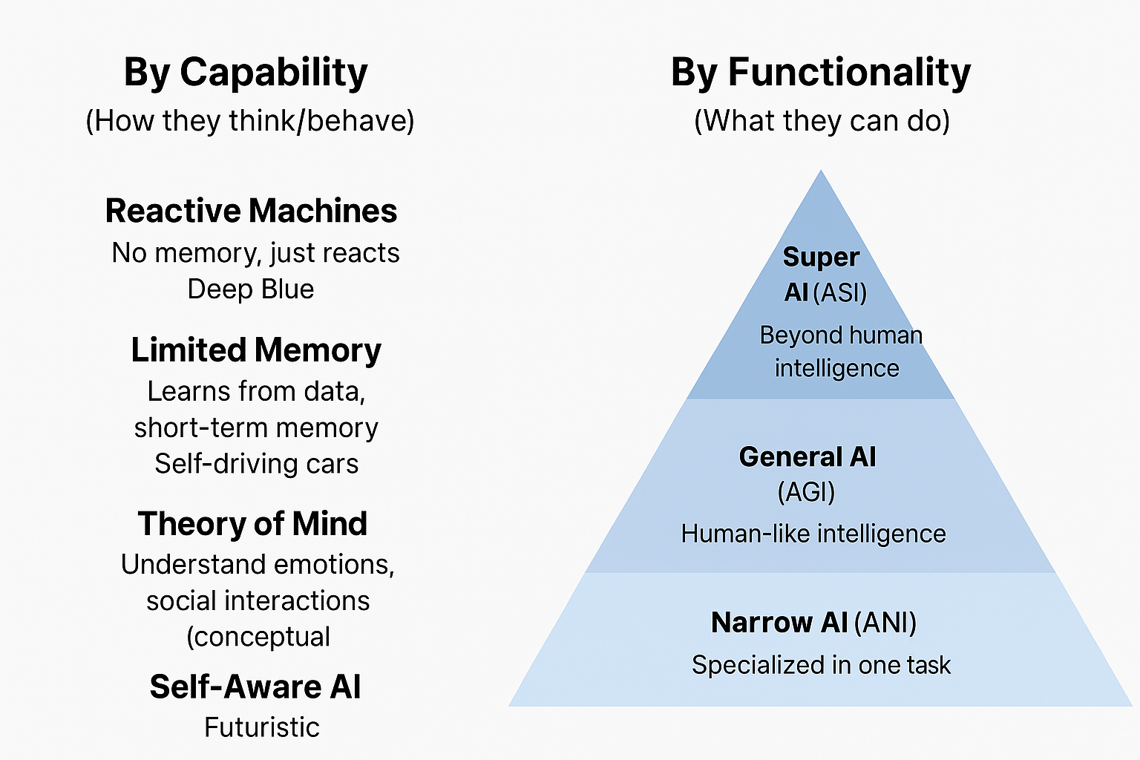
Types of AI
Notes:
By Capability (How they think/behave)
Reactive Machines – No memory, just reacts (e.g., Deep Blue).
Limited Memory – Learns from data, short-term memory (e.g., Self-driving cars).
Theory of Mind – Can understand emotions, social interactions (conceptual).
Self-Aware AI – Conscious, aware of its own existence (futuristic).
By Functionality (What they can do)
Narrow AI (ANI) – Specialized in one task, most current AI today (e.g., Siri, Google Translate). 🔗 Mostly matches Reactive & Limited Memory AI.
General AI (AGI) – Human-like intelligence, can learn & adapt across tasks. 🔗 Aligns with Theory of Mind AI.
Super AI (ASI) – Beyond human intelligence, self-learning, self-aware. 🔗 Matches Self-Aware AI.

Slide 8
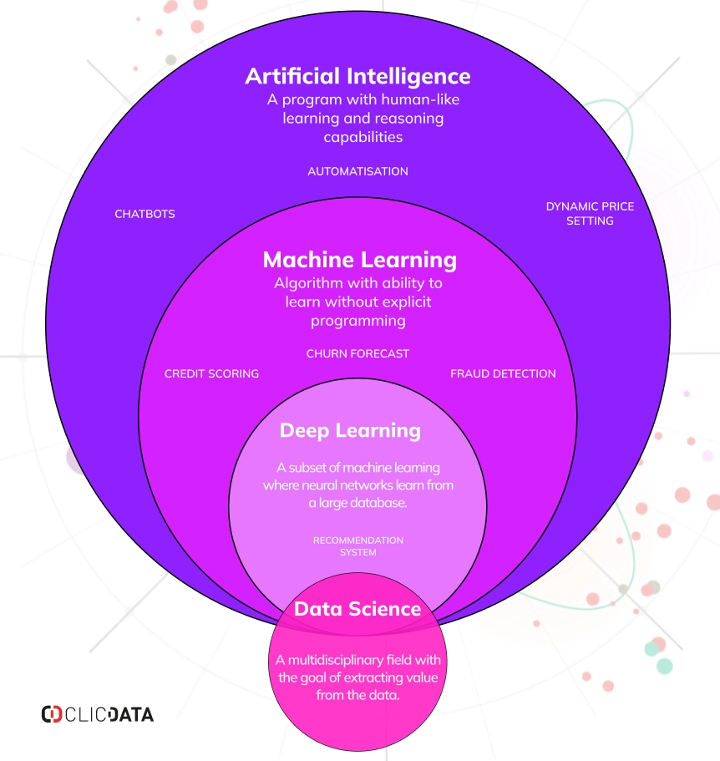
Understanding AI, Machine Learning, Data Science, and Deep Learning
Notes:
Key Points
AI (Artificial Intelligence)
Broadest concept.
Gives machines the ability to imitate human behavior.
ML (Machine Learning)
Subset of AI.
Helps machines self-learn and improve continually.
DL (Deep Learning)
Subset of ML.
Uses complex algorithms & deep neural networks.
Repeatedly trains models/patterns.

Slide 9
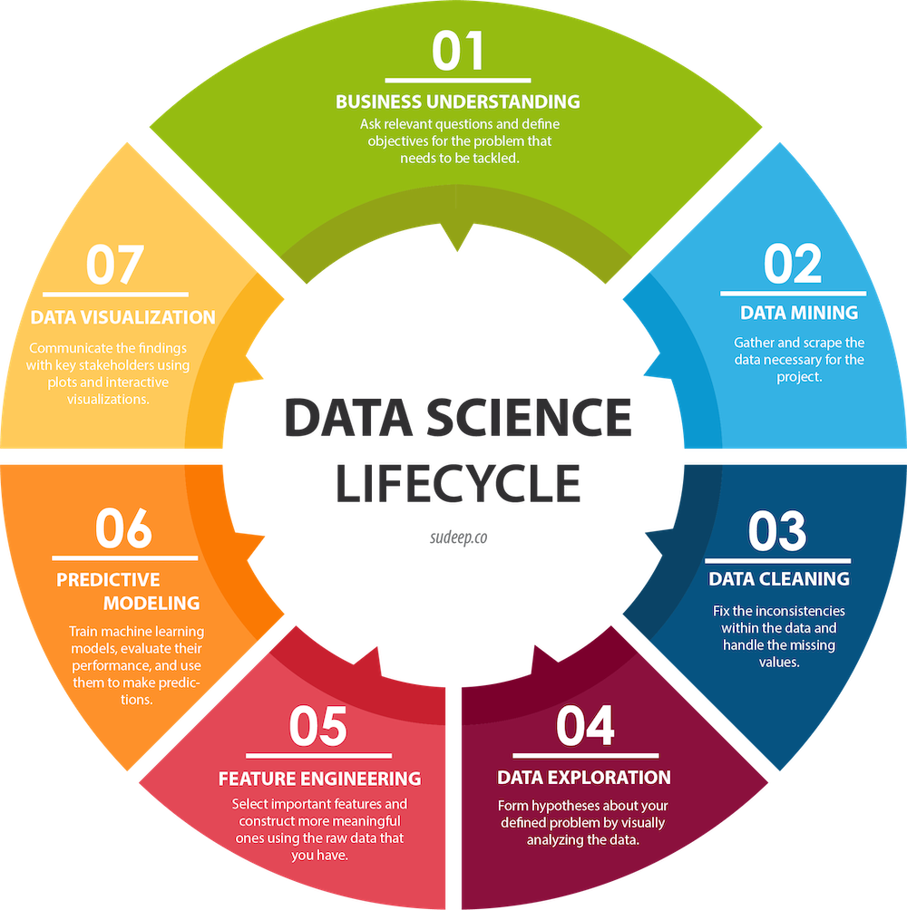
Notes:
Key Points
AI (Artificial Intelligence)
Broadest concept.
Gives machines the ability to imitate human behavior.
ML (Machine Learning)
Subset of AI.
Helps machines self-learn and improve continually.
DL (Deep Learning)
Subset of ML.
Uses complex algorithms & deep neural networks.
Repeatedly trains models/patterns.

Slide 10
CURRENT TRENDS IN THE FIELD
GPT-5 Release (August 2025)
Trump Administration Announces U.S. AI Action Plan (July 2025)
DeepSeek-R1 Release (January 2025)
Anthropic Claude 3 Family Release (March 2024)
Notes:
OpenAI released GPT-5 in August 2025, an AI model that improves upon previous GPT models to provide “expert-level responses.” It offers faster reasoning and broader multimodal input capabilities for handling lengthy, complex conversations, with particular enhancements for collaborative writing and health-related questions.

Slide 11
Frequently Asked Questions
Who is the creator/founder of artificial intelligence?
How does AI work?
How is AI being used today?
What are the types of AI?
What is generative AI?
Notes:
John McCarthy and Alan Turing are widely considered to be the founders of artificial intelligence. Turing introduced the concept of AI and the Turing test in his 1950 paper “Computing Machinery and Intelligence,”
AI works to simulate human intelligence by using algorithms to analyze large amounts of data, identify data patterns and make decisions based on those patterns.
AI is being used to power virtual assistants, personalized content and product recommendations, image generators, chatbots, self-driving cars, facial recognition systems and more.
The 7 main types of artificial intelligence are:
Weak AI or narrow AI
Strong AI, general AI or artificial general intelligence (AGI)
Super AI or artificial superintelligence (ASI)
Reactive machine AI
Limited memory AI
Theory of mind AI
Self-aware AI
Generative AI refers to an artificial intelligence system that can create new content (like text, images, audio or video) based on user prompts. Generative AI is the backbone of popular chatbots like ChatGPT, Gemini and Claude, and can be used to instantly create written copy, reports, code, digital images, music and other media.

Slide 12
Notes:
John McCarthy and Alan Turing are widely considered to be the founders of artificial intelligence. Turing introduced the concept of AI and the Turing test in his 1950 paper “Computing Machinery and Intelligence,”
AI works to simulate human intelligence by using algorithms to analyze large amounts of data, identify data patterns and make decisions based on those patterns.
AI is being used to power virtual assistants, personalized content and product recommendations, image generators, chatbots, self-driving cars, facial recognition systems and more.
The 7 main types of artificial intelligence are:
Weak AI or narrow AI
Strong AI, general AI or artificial general intelligence (AGI)
Super AI or artificial superintelligence (ASI)
Reactive machine AI
Limited memory AI
Theory of mind AI
Self-aware AI
Generative AI refers to an artificial intelligence system that can create new content (like text, images, audio or video) based on user prompts. Generative AI is the backbone of popular chatbots like ChatGPT, Gemini and Claude, and can be used to instantly create written copy, reports, code, digital images, music and other media.

Slide 13
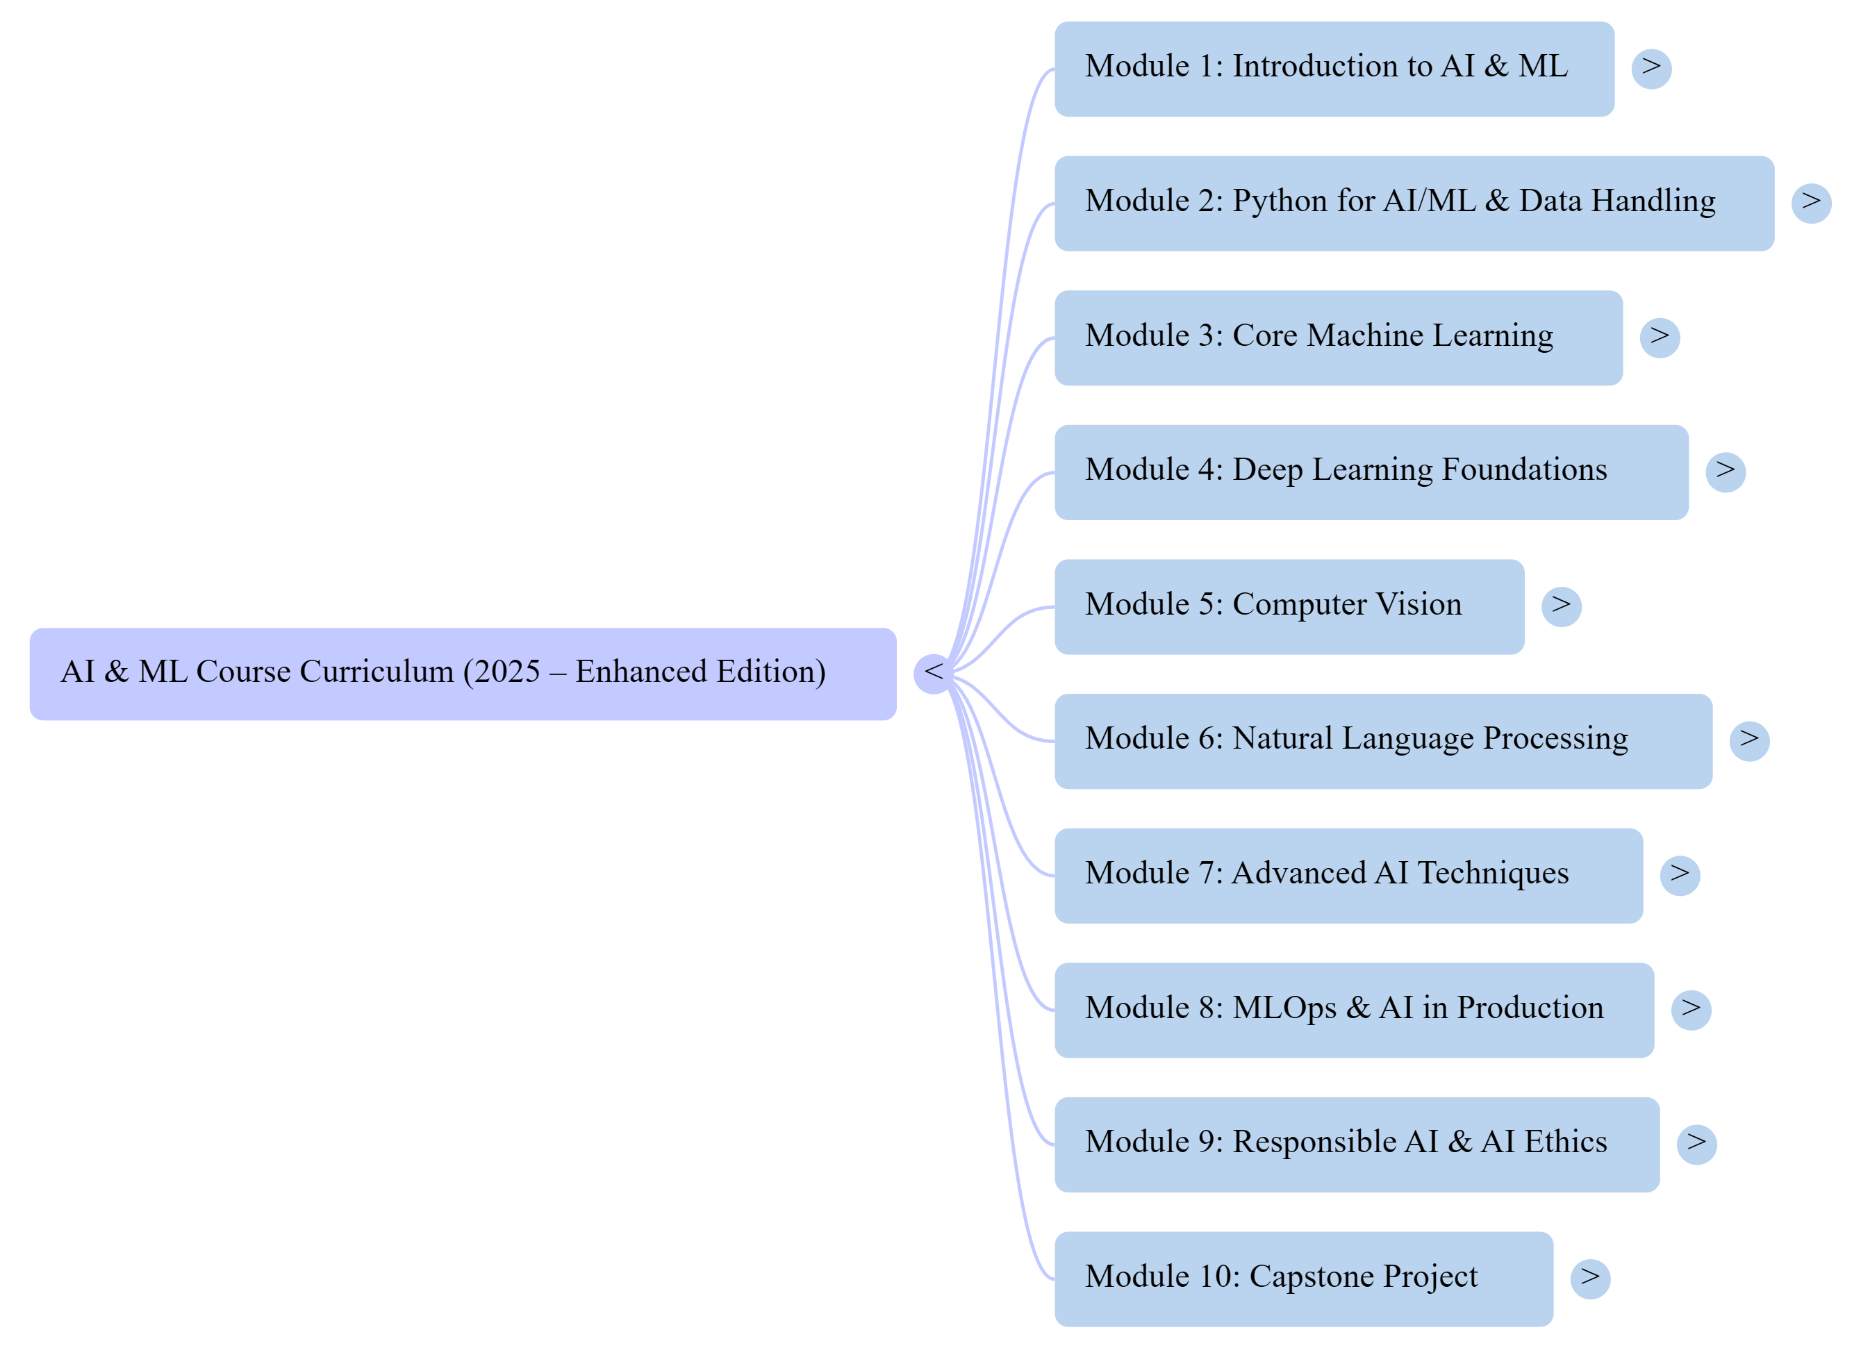

Slide 14
Ready to Take Your First Steps in AI, ML, Deep Learning and Data Science? Master them to unlock data’s true power

